Slide 2
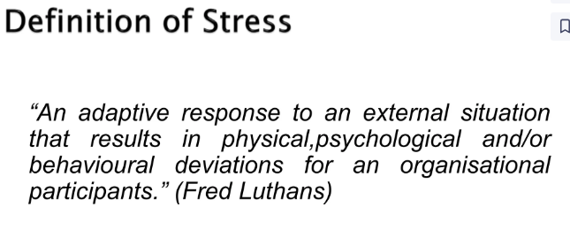
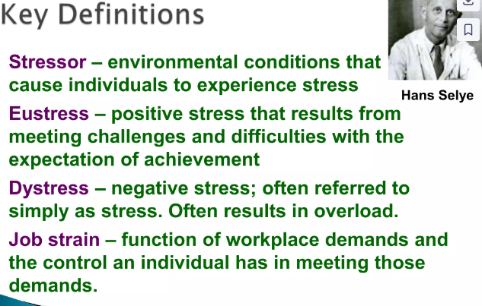
Stress

Slide 3
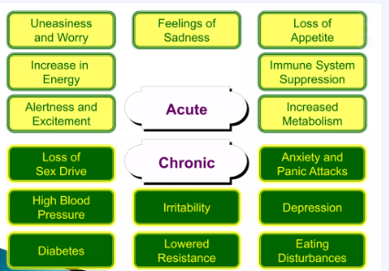

Slide 4
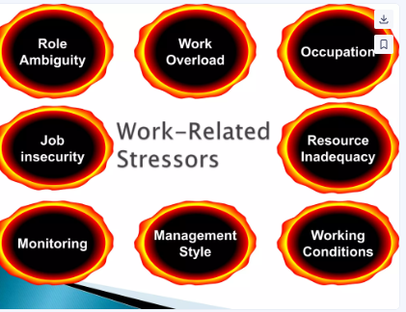

Slide 5
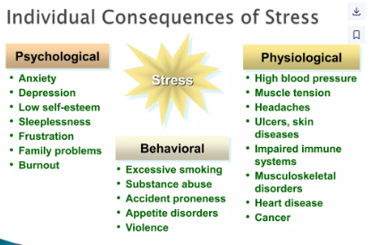

Slide 6
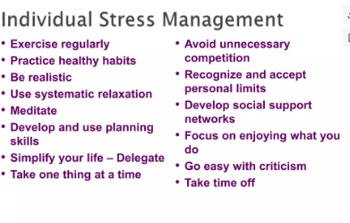
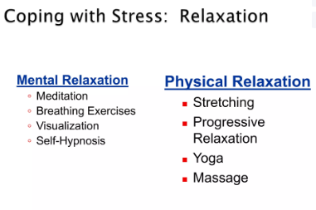
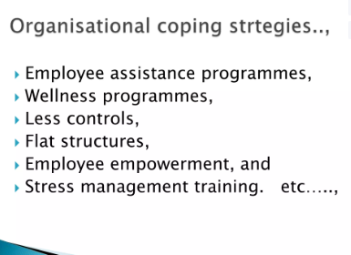

Slide 7
Organisational Behaviour
Topic: Lecture 30 Socialisation
Dr. C. Vijaya Banu
Professor , School of Management
SASTRA Deemed University, Thanjavur – 613 401
vijayabanu@mba.sastra.edu

Slide 8
Socialization
Socialization is the process of working together, of developing group responsibility.
socialization is the process by which the individual learns to conform to the norms of the group
Socialization is a social process through which an individual develops his own self by learning the norms and by knowing about his own self from others.

Slide 9
Socialization
Socialization is the process by which children and adults learn from others.
Many people think that socialization is especially important for infants and children.
Psychologists now realize that socialization continues all across the life span, as long as people continue to learn from social experiences.
Socialization contributes to the development of personality.
Socialization- (lead to specific personality) is a product of society.
Socialization is a process through which the personality of the new born child is shaped and molded.
Through the process, the child learns an approved way of social life.
At the same time, it also provides enough scope for the individual to develop his individual

Slide 10
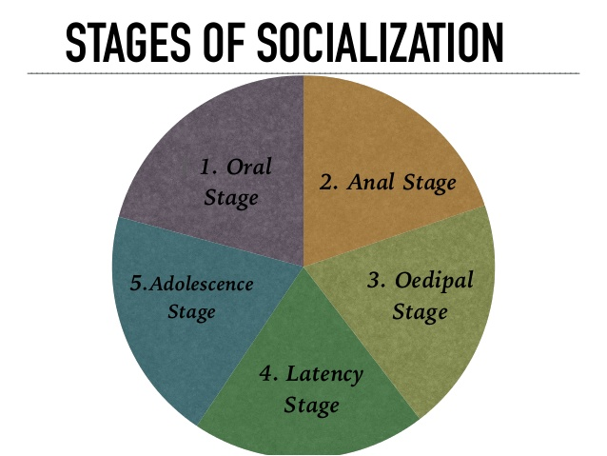
Primary Socialisation

Slide 11
THE ORAL STAGE
➤ It is a stage which begins from birth till child is of 1 year.
➤ It needs to be fed as it is helpless and dependent on others for its very survival.
➤ It also needs to be protected from the cold, damp and other discomforts.
➤ During this stage, the child cries for everything as this is the only way it can communicate its needs.
➤ The aim of oral stage is to establish oral dependency.

Slide 12
THE ORAL STAGE
➤ During the ﬁrst year of its life, the child’s contact with the outside world is through the mouth and lips.
➤ Mother generally starts the process of socialization as the child is dependent on her for its substance.
➤ The child is only concerned with its oral needs.
➤ Freud called this stage as stage of ‘primary identiﬁcation’.
➤ It means that the child merges its identity with that of the mother.
➤ Crying and smiling are forms of early social behaviour.

Slide 13
THE ANAL STAGE
➤ During this stage the child learns that one cannot totally depend on the mother for everything.
➤ The child realizes that there are some things that it must do by itself.
➤ The child undergoes toilet training, acquires other skills.
➤ The child internalizes two separate roles, one’s own and that of the mother.
➤ It is taught to distinguish between wrong and right actions through a system of reward and punishments.

Slide 14
THE OEDIPAL STAGE
➤ It is at this stage that the child becomes a member of the family as a whole.
➤ the child learns to identify itself with the social role ascribed to it on basis of its gender.
➤ According to Freud, the boy develops the ‘Oedipus Complex’ and girl develops ‘Electra Complex’.
➤ In this stage there is a lot of pressure on the child to identify with the right gender.
➤ Boys generally identify with the father and girls their mother.

Slide 15
THE LATENCY STAGE
➤By the beginning of this stage, the child has learnt to be independent in the daily routine at home.
➤He/she learns social norms.
➤This stage has been called ‘gang stage’ by some sociologists.
➤There is greater participation in group activities and group loyalties are considered important.
➤There is greater revolt against adult authority and domination.

Slide 16
ADOLESCENCE STAGE
➤ This stage starts with the onset of puberty & continues through the teenage years.
➤ This is a stage of transition from childhood to maturity during which new patterns of behaviour are learnt to meet the increased demands of the peer group & of adult society.
➤ The adolescent undergoes a number of physiological changes.
➤ Boys & girls try to break free from parental control.

Slide 17
ADOLESCENCE STAGE
➤ Adolescents are generally interested in various recreational activities like T.V. , sports, dance, music, being online networking on facebook,etc.
➤ In modern societies adolescents are encouraged to make their own decisions regarding education, occupation & their marriage partners.
➤ They are also expected to accept greater responsibilities.

Slide 18
Secondary socialization anticipatory socialization
In anticipatory socialization the individual mimic or copy the behavior of his anticipated future role. For example- if one has anticipated his/her future role as a doctor he/she will start picking up doctor’s mannerism.

Slide 19
RE-SOCIALIZATION
Re-socialization is a kind of learning which involves the learning of new ways of thinking, feeling and behaving that are completely different from one’s previous way of life.

Slide 20
REVERSE-SOCIALIZATION
In reverse-socialization the younger generation transfers knowledge to the older generation. This occurs mostly in industrial societies where the pace of technological change is very rapid.

Slide 21
Sigmund Freud(1856-1939)
Explained the process of socialization through three stages-
ID-is a real pleasure seeker and it wants immediate gratification. It works on pleasure principle.
EGO-it keeps desire realistic and under control. The function of Ego based on reality principle.
SUPER-EGO- it represents society’s norms and values. It leads to the perfection of human action and controls both ID and EGO. It will give strong sense of right and wrong.

Slide 22
AGENCIES of SOCIALIZATION
FAMILY
SCHOOL
PEER- GROUP
MASS- MEDIA

Slide 23
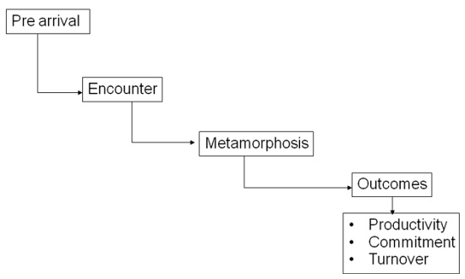
Socialisation-stages

